Slide 1
Stallion Tea Bag Tracking Application
Tea Bag Tracking Application

Slide 2
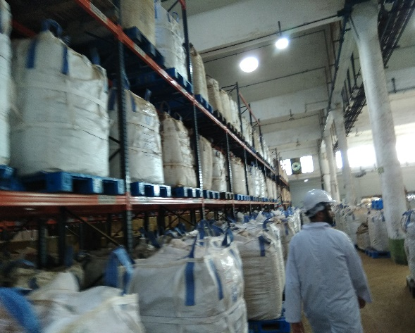
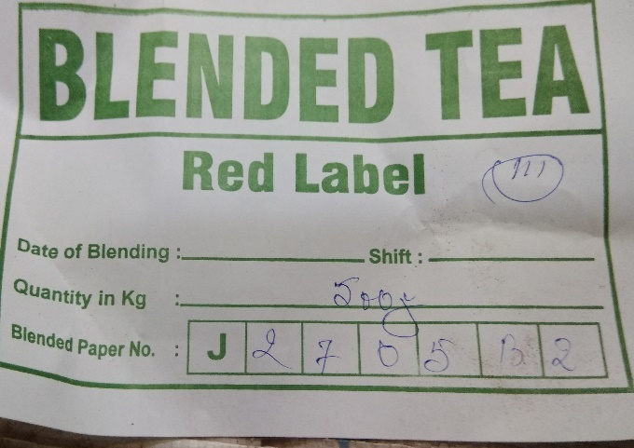
Present workflow of Big Tea Bag
Big Tea bag full of different blend coming to factory from different Tea garden .Each bag will empty within 21 days interval and again fill with tea of different blend . If this big tea bag not used within 21 days it will be treated as waste material. Each Big Tea Bag size 1 meter length x 1 meter width x 5 feet height. Weight 700 kg. At the time of filling each Big tea bag manual hand written process will be applied with relevant to 5 basic parameter. 1.Date & Time of production,2)Blend Name, 3)Net weight, 4)Blend Paper Name 5)Mix number .
At the time of packing small tea box they cross check manually with this hand written paper data and small box skf number QR code if both numbers blend name are match then the correct blend tea is there for small box packing. if not match then they will change the bag immediately. If by mistake different bend of tea will mix then huge loss will be occurred.

Slide 3
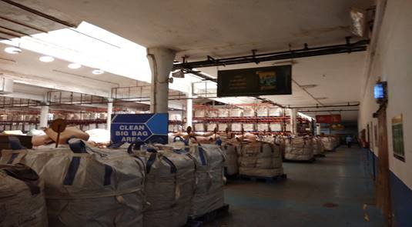
Overall Solution
Apply RFID tag for Big Tea bag
Assign product against RFID Tag (Big Tea Bag)
Assign RFID Tag for Racks /Pallet
Storage of Big Tea bag in to storage with Rack RFID tag and Tea bag RFID tag reading
Picking of Tea bag from rack RFID tag and Tea bag RFID tag reading using FIFO method
Cross checking of Tea bag & Pallet RFID tags with hotter alarm for the wrong pair
Portable scanner searching option for Tea bag RFID tag

Slide 4
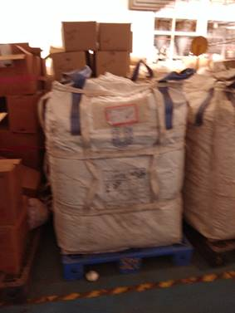
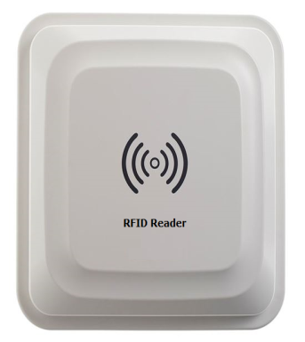
Assigning Product
Operator Can assign Product details Assign to Big Tea bag RFID Tag

Slide 5
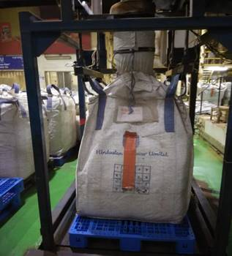
Tea Bag Filling Section
1. DATE & TIME OF PRODUCTION
2. BLEND NAME
3. NET WEIGHT
4. BLEND PAPER NAME
5. MIX NUMBER
RFID TAG
DATA
RFID READER
STALLION SERVER
REPORTS
BEFORE STARTING A BATCH OF BIG TEA BAG FILLING,USER WILL ENTER THE RESPECTIVE PARAMETERS AND WILL PRESS THE START BUTTON.EACH BIG TEA BAG WILL BE PROVIDED WITH A RFID TAG INITIALLY.ONCE THE TEA BAG REACHES THE FILLING STATION FOR FILLING,THE READER WHICH IS FIXED IN THE FILLING STATION WILL READ THE TAG ID AND WILL ASSIGN TO THE OTHER DETAILS AND WILL BE SAVED TO THE DATABASE.IF MATCH WITH DATABASE THEN OPERATOR START FILLING BIG TEA BAG .

Slide 6
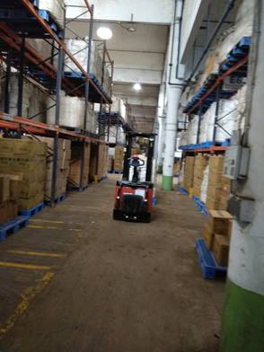
Put Away & Picking of Tea bag from Rack
RFID reader in Forklift will read Rack Tag & Tea bag RFID tag
Rack wise inventory will be updated against put away & picking
Data validation while put away & Picking
Storage report & Picking reports

Slide 7
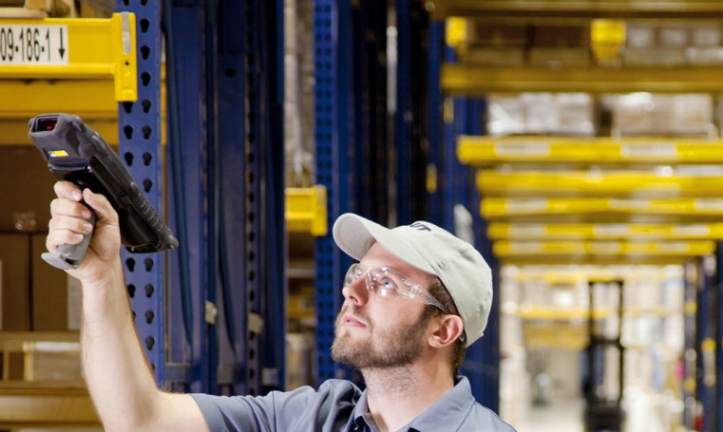
Packing Validation & Product Search
Validation in the time of packing using fixed
RFID reader
Pallet & Big Tea bag RFID tag verification
Hotter Alarm for mismatch
Portable reader for RFID Bag Searching
Sound notification while product searching

Slide 8
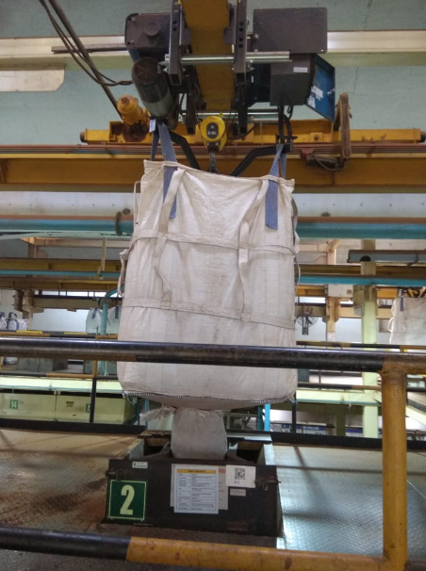
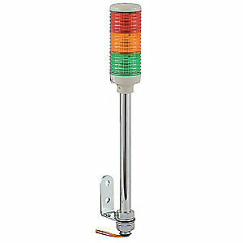
Tea Bag Packing section
1. Blend Name
RFID TAG
DATA
RFID READER
STALLION SERVER
BUZZER LIGHT
REPORTS
AT THE TIME OF PACKING SKU.RFID FIXED READERS WILL BE INSTALLED IN EACH HOPPER AREA.USER WILL SELECT OR ENTER THE REQUIRED BLEND NAME AND WILL PRESS THE START BUTTON.WHILE PACKING ,THE FIXED READER WILL READ THE BIG TEA BAG RFID TAG AND WILL VALIDATE.IF BOTH DATA DOESN'T MATCHES THEN AN BUZZER WITH HOOTER LIGHT WILL BLOW ALARM.

Slide 9
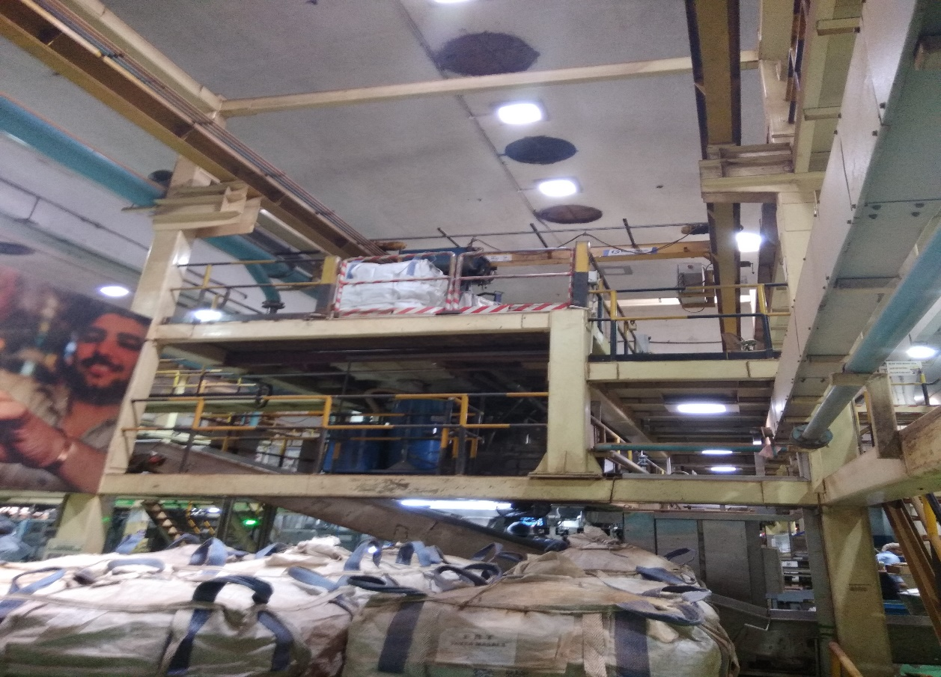
Benefits of RFID Tracking
Increases asset visibility
Eliminates any delay in product deliveries
Mitigates loss and risk
Reduces labour costs and increases productivity
Quick, Precise Identification for Inventory
Live Accurate Database
Faster Distribution

Slide 10
Thanks You
THANK Y
For your wathcing

